Slide 1
Artificial organs
Heart disease is a leading cause of death and contributes to more than 30% of total deaths
Respiratory failure accounts for the fourth leading cause of death followed by kidney and liver failure
The current gold standard for treating organ failure is transplantation. But in this case, donors are the bottle neck followed by compatibility without evoking any allergic reactions
The only alternative for these patients today is the supportive management offered by artiﬁcial organ systems. The design and development of the most of the artiﬁcial organ systems can be traced to the 1950s and 1960s

Slide 2
The substitution of organ function by artiﬁcial organs represents one of the most remarkable achievements in the 20th century
It is currently estimated that more than 20 million people worldwide derive beneﬁt of prolonging the organ function and quality of life with the use of some kind of artiﬁcial medical implant
The history of organ replacement can be traced to human origins. This happened when the primitive man took support of a wooden stick to support an injured limb.
However, the replacement or mimicking of the internal human organs had to wait until after the industrial revolution, which brought about the technical expertise combined with newer insights and understanding of human anatomy and functioning.

Slide 3
The original dream of Charles Lindbergh to bypass the function of the heart and lungs to correct heart defects was, when Gibbon developed a heart– lung machine in 1950s
Willem Kolff, who saw a young patient dying of kidney failure, reasoned that if urea can be removed from the blood, then that can prevent patients from dying. Using a simple sausage tubing made of cellophane he was able to remove urea from the blood; this lead to the development of the artiﬁcial kidney or what we call today, the hemodialysis machine

Slide 4
Bioartificial organ manufacturing technologies are a series of enabling techniques that can be used to produce human organs based on bionic principles.
During the last ten years, significant progress has been achieved in the development of various organ manufacturing technologies. According to the degree of automation, organ manufacturing technologies can be divided into three main groups:
fully automated;
semi-automated;
hand worked (or handmade);
Each has the advantages and disadvantages for bioartificial organ manufacturing.
One of the most promising bioartificial organ manufacturing technologies is to use combined multi-nozzle three-dimensional printing techniques to automatically assemble personal cells along with other biomaterials to build exclusive organ substitutes for defective/failed human organs

Slide 5
Organ failure is the leading cause of mortality all over the world despite advances in interventional, pharmacological, and surgical therapies.
Currently, orthotopic organ transplantation (in which the native organ is removed and replaced by the donor organ in the same anatomic location as the organ) is the only effective way to achieve this; however, it is seriously limited by issues such as donor shortage, high price, immune rejection and ethical conflict.
With rapid developments in science and technology, some advanced material processing technologies, such as multi-nozzle rapid prototyping (MNRP), additive combined molding (or additive combined molds), decellularized matrix regeneration, electrophoresis, and magnetic adsorption of cells have emerged, making the area of bioartificial organ manufacturing more and more attractive.
A common feature of advanced organ manufacturing technologies is that they have the capacity to integrate heterogeneous cell types and multiple materials to recapitulate native organ geometries, constituents and functions.

Slide 6
Major concerns of bioartificial organ manufacturing technologies are assemble heterogeneous living cells with predesigned architectures, including hierarchical vascular, neural and/or lymphatic networks, while ensuring that the corresponding functionality.
Generally, an artificial organ is an engineered device that can be implanted or integrated into a human body—interfacing with living tissue—to replace a natural organ, to duplicate or augment a specific function or functions so the patient may return to a normal life as soon as possible.
According to the materials used, artificial organs can be divided into three main classes:
(1) mechanical, made of inanimate polymers (i.e., plastics) and/or metals;
(2) biomechanical, made of partially living cells and inanimate polymers and/or metals; and
(3) Biological (i.e., bioartificial) , made of living cells, biodegradable polymers and/or metal elements

Slide 7
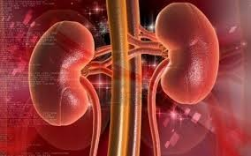
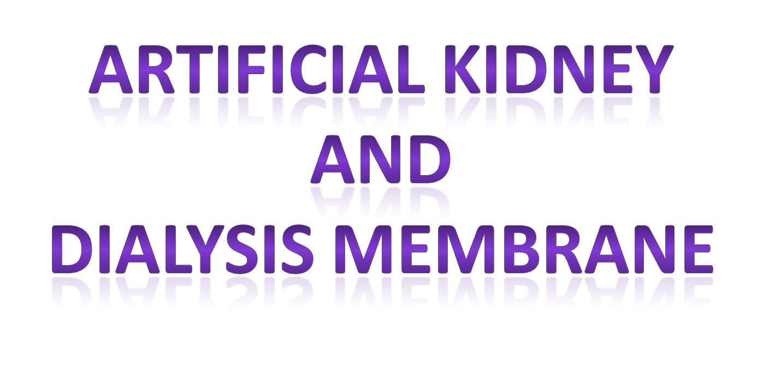

Slide 8
ARTIFICIAL KIDNEY
The earlier advances consisted of an artiﬁcial kidney made at Johns Hopkins by Abel and colleagues in 1913 using colloidon and hirudin anticoagulant.
It took another 15 years before the modiﬁcation of the Hopkins kidney was used by Hass in Germany to perform ﬁrst clinical hemodialysis
The modern dialyzers consist of semipermeable membranes which are conﬁgured into a hollow ﬁber design.
These membranes are essentially cellulose derived or noncellulose synthetic polymers. High ﬂux membranes have a higher ultra ﬁltration coefﬁcient which facilitates higher clearance of the solutes during ﬂuid removal.

Slide 9
Although hemodialysis revolutionized the treatment of kidney failure, it is far from perfect in mimicking the functions of the kidney.
Patients need to be hooked to the machine for prolonged periods and therefore limit their mobility.
Besides removing the toxic waste and maintaining the electrolyte and water balance, the human kidney plays an important role in terms of endocrine and metabolic activities.
To solve this problem, and mimic the functioning of a normal human kidney, developments are underway to develop a bio-artiﬁcial kidney which incorporates tubular cells in the hollow ﬁbers
https://www.youtube.com/watch?v=pSxS1UuLg5Y
https://www.youtube.com/watch?v=t3Bwrp3wMcw

Slide 10
Kidneys are the main excretory organs of the body.
Located near the back of the abdomen behind the intestines.
The kidneys are two reddish-brown bean shaped organs 10cm long and 6cm wide.
Main Functions
Ion Balance - Especially Na+ and K+
Osmotic Balance - Determine volume of urine produced
Blood Pressure - Controls blood volume and ECF volume
pH Balance - Retains or excretes H+ or HCO3⁻
Excretion - of nitrogenous wastes & other hydrophilic toxins
Hormone Production-Renin, Erythropoietin

Slide 11
Function of the Kidney
➢
Remove undesirable substances from the blood plasma:
•
•
•
•
Toxins
Metabolism wastes
Excess of ingested water Excess of mineral salts
Regulate the Acidity of blood
25% of the blood flows through the kidneys (1,2 l/min)
➢
➢

Slide 12

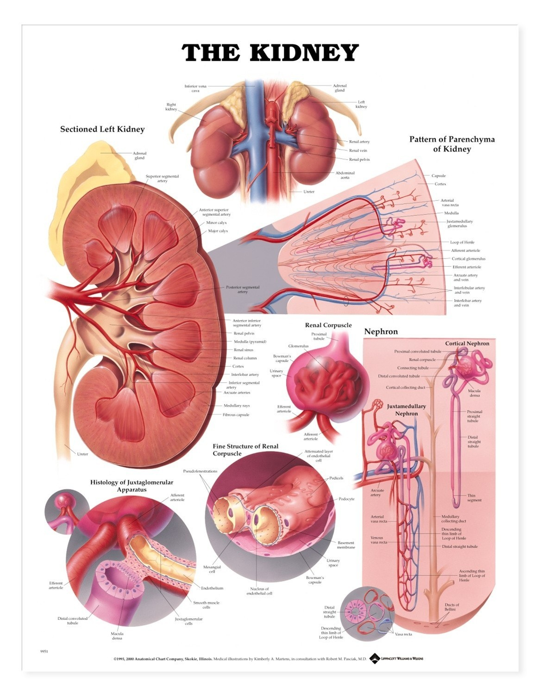
The renal veins are veins that drain the kidney. They connect the kidney to the inferior vena cava
Renal Artery
The renal arteries normally arise off the abdominal aorta and supply the kidneys with blood.
Ureters
The Ureters are two tubes that drain urine from the kidneys to the bladder
Nephrons
A nephron is the basic structural and functional unit of the kidney. There are about a million nephrons in each kidney. Its chief function is to regulate water and soluble substances by filtering the blood, reabsorbing what is needed and excreting the rest as urine. Nephrons eliminate wastes from the body, regulate blood volume and pressure, control levels of electrolytes and metabolites, and regulate blood pH
Glomerulus
The glomerulus is a capillary tuft that receives its blood supply from an afferent arteriole of the renal circulation.

Slide 13
Afferent/Efferent Arterioles
The afferent arteriole supplies blood to the glomerulus.
Renal capsule ( Bowman’s capsule)
The glomerulus is enclosed by the renal capsule (or Bowman’s capsule)- the first part of the nephron. The arteriole leading into the glomerulus is wider than the one leading out, so there is high blood pressure in the capillaries of the glomerulus and cause ultra filtration of blood.
Proximal Convoluted Tubule
The proximal convoluted tubule is the longest (14mm) and widest (60μm) part of the nephron. It is lined with epithelial cells containing microvilli and numerous mitochondria. In this part of the nephron over 80% of the filtrate is reabsorbed into the tissue fluid and then to the blood.
Loop of Henle
The loop of Henle is a U-shaped tube that consists of a descending limb
and ascending limb. Its descending limb is permeable to water but completely impermeable to salt but ascending limb is permeable to sodium and impermeable to water.
Distal Convoluted Tubule (DCT)
The distal convoluted tubule is similar to the proximal convoluted tubule in structure and function. With the help of endocrine system DCT reabsorb more calcium and sodium and it excrete more phosphate and potassium. Here again water is reabsorbed with the help of ADH.
Ureter
The collecting ducts all join together in the pelvis of the kidney to form the ureter and finally goes to urinary bladder.

Slide 14
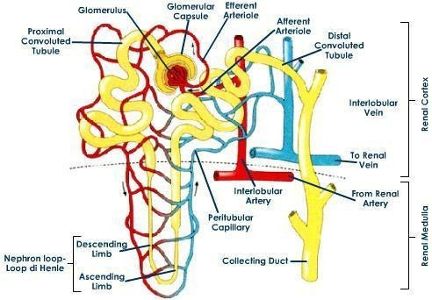

Slide 15
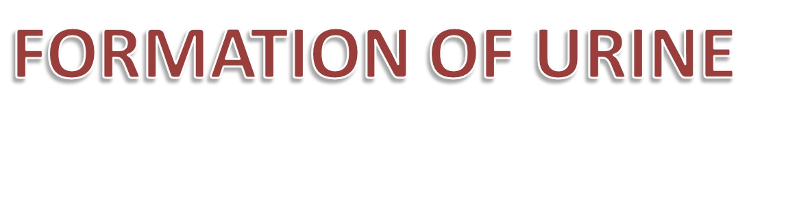
Urine is formed in three steps:
Filtration
Reabsorption
Secretion.

Slide 16
Filtration
Blood enters the afferent arteriole and flows into the glomerulus. The arteriole leading into the glomerulus is wider than the one leading out, so there is high blood pressure in the capillaries of the glomerulus. This pressure forces plasma out of the blood by ultra filtration. All molecules with a molecular mass of < 68,000 are squeezed out of the blood to form a filtrate in the renal capsule. Only blood cells and large proteins (e.g. antibodies and albumin) remain in the blood.
REABSORPTION In PCT
80% of the Reabsorption takes place in PCT All glucose, all amino acids and 85% of minerals are reabsorbed by active transport, 80% of the water is reabsorbed to the blood by osmosis from the filtrate to the tissue fluid and then diffuse into the blood capillaries.
Small proteins are reabsorbed digested, and the amino acids diffuse into the blood.
Small proportion of urea is also reabsorbed in PCT

Slide 17
REABSORPTION In LOOP OF HENLE
The descending limb is impermeable to ions, but some water leaves by osmosis and filtrate become more concentrated.
The ascending limb contains a Na⁺ and a Cl⁻ pump, so these ions are actively transported out of the filtrate into the surrounding tissue fluid.

Slide 18
REABSORPTION In Distal convoluted tube
The distal convoluted tubule reabsorbs more calcium and excretes more phosphate.
Glomerular filtrate has now been separated into two forms:
Reabsorbed Filtrate and Non-reabsorbed Filtrate.
Non-reabsorbed filtrate is now known as tubular fluid as it passes through the collecting duct to be processed into urine.
Some substances are removed from blood through the peritubular capillary network into the distal convoluted tubule or collecting duct. These substances are Hydrogen ions, creatinine, and drugs. Urine is a collection of substances that have not been reabsorbed during glomerular filtration or tubular reabsorbtion

Slide 19
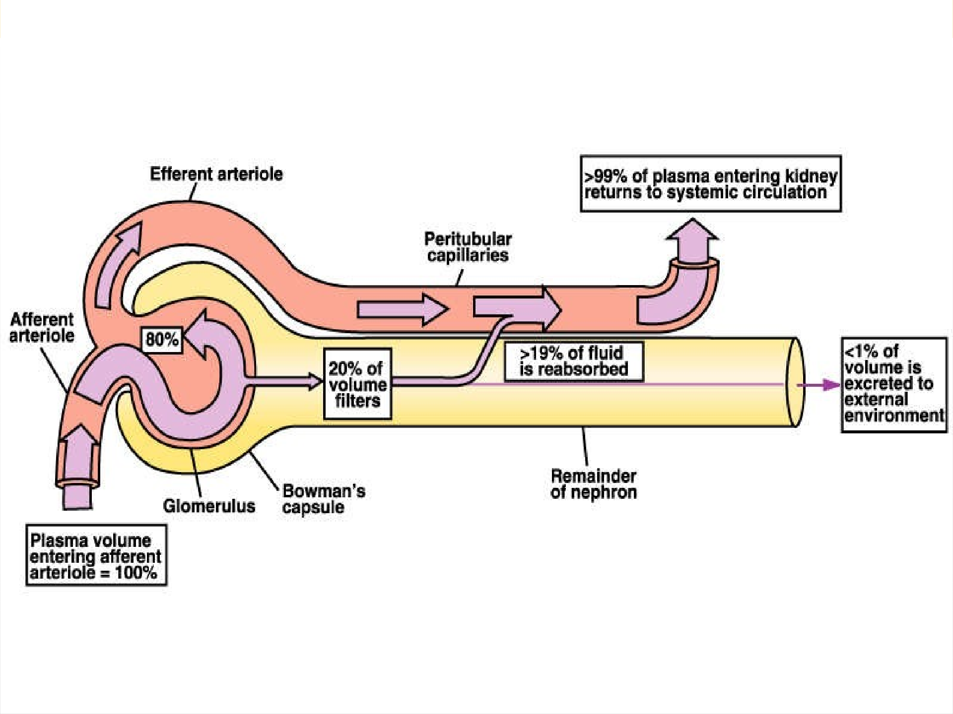

Slide 20
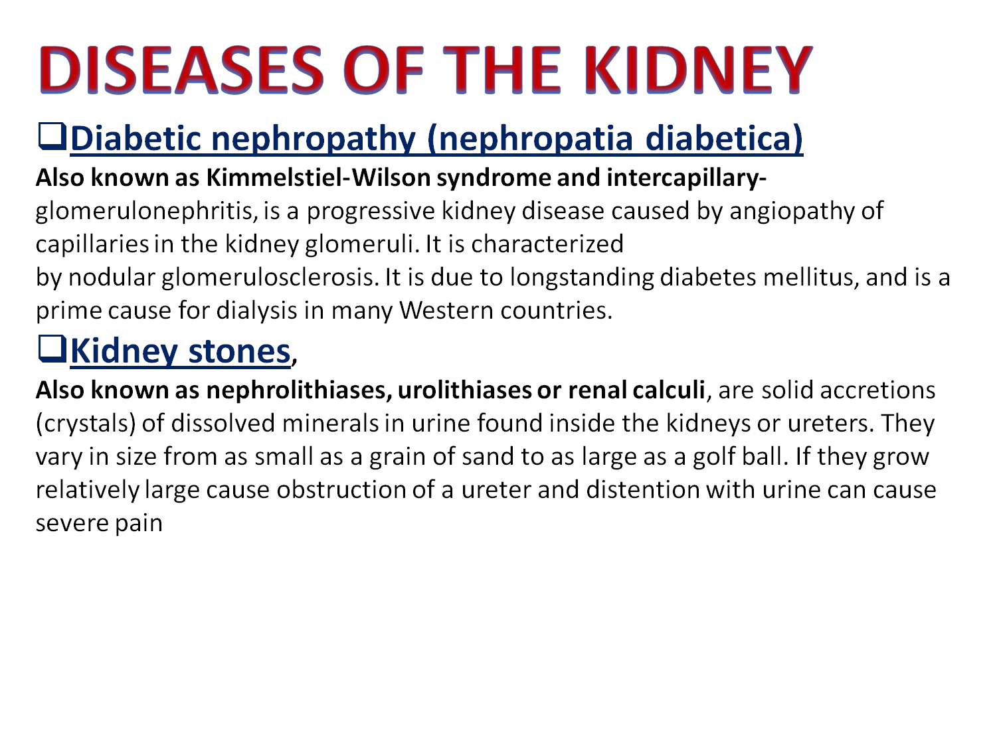
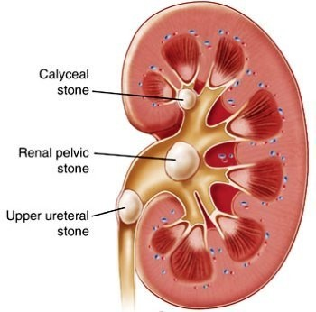

Slide 21
Glomerulonephritis
Inflammation of the glomerular can be caused by immunologic abnormalities, drugs or toxins, vascular disorders, and systemic diseases. Glomerulonephritis can be acute, chronic or progressive. Two major changes in the urine are distinctive of glomerulonephritis
: hematuria and proteinuria with albumin as the major protein.
There is also a decrease in urine as there is a decrease in GFR (glomerular filtration rate). Renal failure is associated with oliguria (less than 400 ml of urine output per day).
Renal Failure
Uremia is a syndrome of renal failure and includes elevated blood urea and creatinine levels. Acute renal failure can be reversed if diagnosed early. Acute renal failure can be caused by severe hypotension or severe glomerular disease. It is considered to be chronic renal failure if the decline of renal function to less than 25%.

Slide 22
Diabetes Insipidus
This is caused by the deficiency of or decrease of ADH. The person with (DI) has the inability to concentrate theirurine in water restriction, in turn they will void up 3 to 20 liters/day.
Urinary tract infections (UTI's)
The second most common type of bacterial infections seen by health care providers is UTI's. Out of all the bacterias that colonize and cause urinary tract infections the big gun is Escherichia coli. In the hospital indwelling catheters and straight catheterizing predispose the opportunity for urinary tract infections.

Slide 23


Slide 24
ARTIFICIAL KIDNEY(HEMODIALYZERS)
Artificial kidneys or hemodialysers are used in extracorporeal renal- therapies for removal of uremic solutes and excess plasma water from the blood of patients with kidney failure.
History of Artificial Kidney
The first scientific description of hemodialysis principle was published by Graham in 1854.
The first prototype hemodialyzer was developed by Abel,Rowntree and Tunner in 1913.
The first hemodialyzer used on human was reported by Hass in 1923.
Kolf developed the rotating drum artificial kidney in 1945 and is succeeded in treating ARF for the first time and it is modified in 1956
In 1960,a plate and frame hemodialyzer called Killi dialyzer was developed by Killi.

Slide 25
ARTIFICIAL KIDNEY(HEMODIALYZERS)
Artificial kidneys or hemodialysers are used in extracorporeal renal- therapies for removal of uremic solutes and excess plasma water from the blood of patients with kidney failure.
History of Artificial Kidney
The first scientific description of hemodialysis principle was published by Graham in 1854.
The first prototype hemodialyzer was developed by Abel,Rowntree and Tunner in 1913.
The first hemodialyzer used on human was reported by Hass in 1923.
Kolf developed the rotating drum artificial kidney in 1945 and is succeeded in treating ARF for the first time and it is modified in 1956
In 1960,a plate and frame hemodialyzer called Killi dialyzer was developed by Killi.

Slide 26
Hollow fiber hemodialyzers
A typical hollow fiber hemodialyzer contains between 6000 and 12,000 hollow fibers depending up on the size of the hemodialyzer.
These hollow fibers have an inner diameter of about 200µm and wall thickness between 15 and 50µm.
They act as a semi permeable membranes for the mass transfer of uremic solutes and excess plasma water from the blood to the dialysate.
These hollow tubers are potted with either PU or epoxy at both end of the hemodialyzer to form tube sheets
The size is depend on the size of the patient.
Hollow shape is preferred because it has higher surface area per unit blood volume and there by maximizing the overall mass-transfer surface compared to other shape.

Slide 27
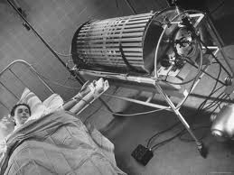
A hollow fiber hemodialyzers has two compartments called blood and dialysate compartment.
The tube side(inside the lumen of hollow fibers) is called blood compartment and the shell side(out side of the lumen hollow fibers )is called the dialysate compartment.
The blood and dialysate are introduced counter currently through the hemodialyzer to optimize the mass transfer 0f solute by enhancing their concentration difference across the hollow-fiber membrane.
Blood flow rate and dialysate are between 200 and 400mL/min and 500 and 800mL/min respectively. Flow rate is depends up on the physical condition of patients.
In 1964 ,the hollow-fiber hemodialyzers called the capillary kidney was First proposed by Stewart,Creny and Mahon. Hollow-fiber type hemodialyzers are the most widely used

Slide 28
Artificial kidney or hemodialyser works on the principle of dialysis which is the diffusion of small solute molecules through a semi permeable membrane.
Blood is removed from the body and pumped by a machine outside the body into a dialyzer (artificial kidney)
The dialyzer filters metabolic waste products from the blood and then returns the purified blood to the person
The total amount of fluid returned can be adjusted
A person typically undergoes hemodialysis at a dialysis centre
Dialysate is the solution used by the dialyzer

Slide 29
HD consists of perfusion of heparinized blood and physiologic salt solution on opposite sides of a semi permeable membrane
•
•
Waste products (urea, creatinine,…ets) move from blood into the dialysate by passive diffusion along concentration gradient
Diffusion rate depends on;
•
The difference between solute concentrations in the blood and dialysate
Solute characteristics
Dialysis filter composition
Blood and dialysate flow rate

Slide 30
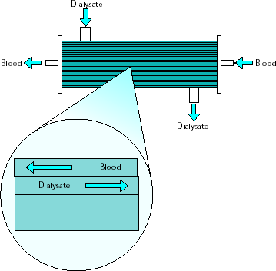
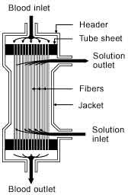
Blood from the patient is circulated through a synthetic extracorporeal membrane and returned to the patient. The opposite side of that membrane is washed with an electrolyte solution (dialysate) contain- the normal constituents of plasma water

Slide 31
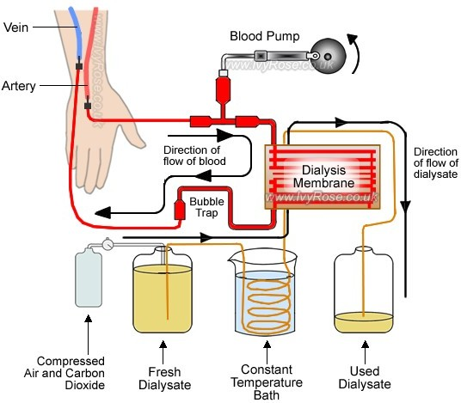

Slide 32
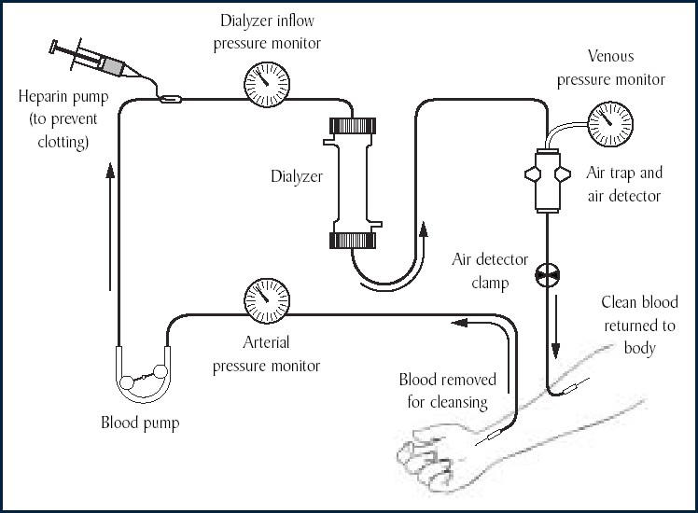

Slide 33

Dialysis membrane act as a semi permeable barrier for the removal of uremic solute and excess plasma water from the plasma water.
They very according to their morphology and chemical composition.
The morphology determine transport properties of the uremic solute while chemical composition determines the biocompatibility of the molecule .
CLASSIFICATION OF DIALYSIS MEMBRANE
Dialysis membrane can be classified in to three based up on their polymeric composition and preparation process. They are:
Regenerated cellulosic membrane
Modified cellulosic membrane
Synthetic membrane

Slide 34
Regenerated cellulosic membrane
Regenerated cellulosic membrane s are the first generation of dialysis membrane with low water solute permeabilities.
They are made from cellulose.
These membrane are highly hydrophilic because of the presence of large number of hydroxy group in their backbone.
The hydrophilic nature of these membrane promote complement activation in dialysis membrane by the interaction of complement cascade products with the hydroxyl group found in the membranes.
Regenerated cellulosic membrane offer great permeabilities on middle molecules and low molecular weight proteins.
Examples of regenerated cellulosic membrane is Cuprophane,which is still being used in more than 50% of all hemodialysers throughout the world.
Popularity of Cuprophane membrane is decreased because of the lack of biocompatibility and poor clearance on middle molecule and low molecular weight proteins.

Slide 35
Modified cellulose membrane in which cellulose under go etherification with the benzyl group. It is marketed as SMC.
Hemophan is another commonly used synthetically modified membrane in which 5% of hydroxyl group is substituted with
diethylaminoethyl(DEAE ) .
DEAE groups are bulky and they shield the hydroxyl group by steric hinderance so they slow down the degree of complement activation and leukopenic response.
These membrane shows more biocompatibility compared to cellulose acetate and followed by Cuprophane.

Slide 36
These are the most widely used synthetic dialysis membrane.
Capacity to remove a broad range of uremic toxins.
Effectively retain endotoxins
Provide intrinsic biocompatibility
Low cytotoxicity
Higher sieving capacity
To incorporate specific property it can be blended with other polymer such as polyvinylpyrrolidone(PVP)
PSF membrane varies because of the variations in the relative amount of copolymer and the fibre processing process employed.

Slide 37
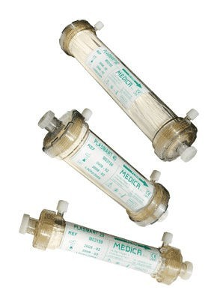
Prepared by high advance spinning technology.
Outstanding middle molecule removal with minimal albumin loss.
They are biocompatible.
Blended with hydrophilic component improve the trans membrane solute passage.

Slide 38
Dialysis
➢
Process of removing waste products and excess fluid from the body
Also controls blood pressure and helps body to keep proper balance of chemicals such as potassium, sodium, and chlorine.
➢
➢
There are two methods:
✓
Hemodialysis (HD)
Peritoneal dialysis (PD).
✓

Slide 39
How does dialysis work?
➢
It uses a membrane as a filter and a solution called dialysate to regulate the balance of fluid, salts and minerals carried in the bloodstream.
➢
The toxins pass from the blood through the membrane and into the dialysate to be taken away.
➢
These toxins would normally be filtered by the kidneys and taken away in urine.

Slide 40
Hemodialysis
➢
The process takes place outside the body
A dialysis machine pumps small amounts of blood out of the body and through a filter called an artificial kidney or Dialyzer.
The Dialyzer filters extra fluid & wastes from blood. The Blood is then pumped back into the body.
➢
➢
➢

Slide 41
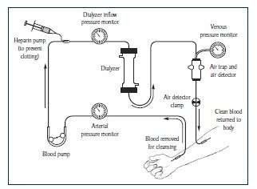
Fig. Hemodialysis setup

Slide 42
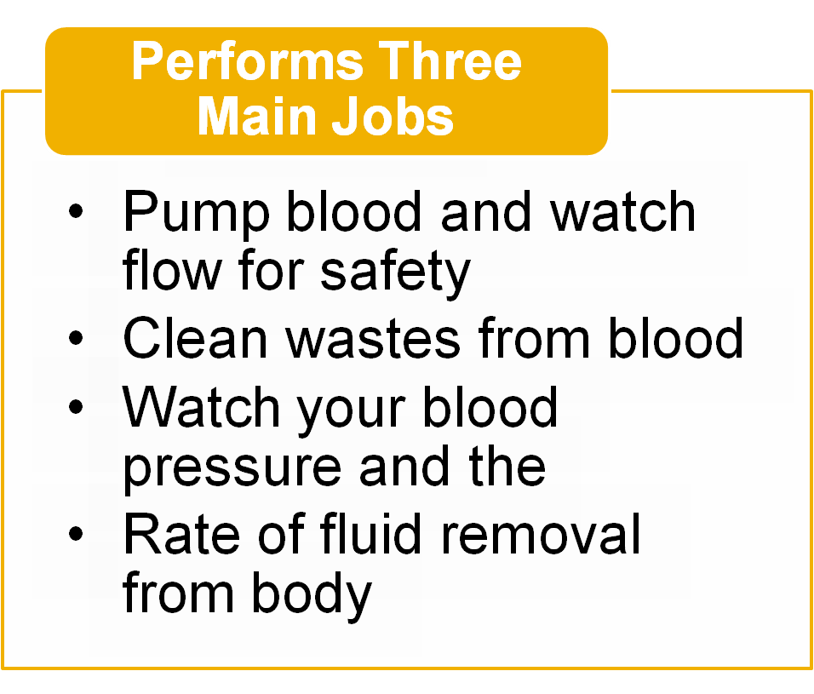
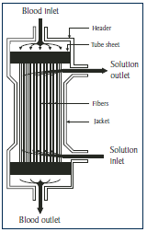
Dialyzer

Slide 43
Dialyzer contd…
The dialyzer is a large container containing thousands of small fibers through which blood is passed.
Fluid, called dialysate, is added to the Dialyzer to :
➢
➢
Help filter out extra fluid and wastes
Add chemicals that your body uses
The Dialysate is pumped around the fibers. The fibers allow wastes and extra fluids to pass from blood into the solution, which carries them away.
➢

Slide 44
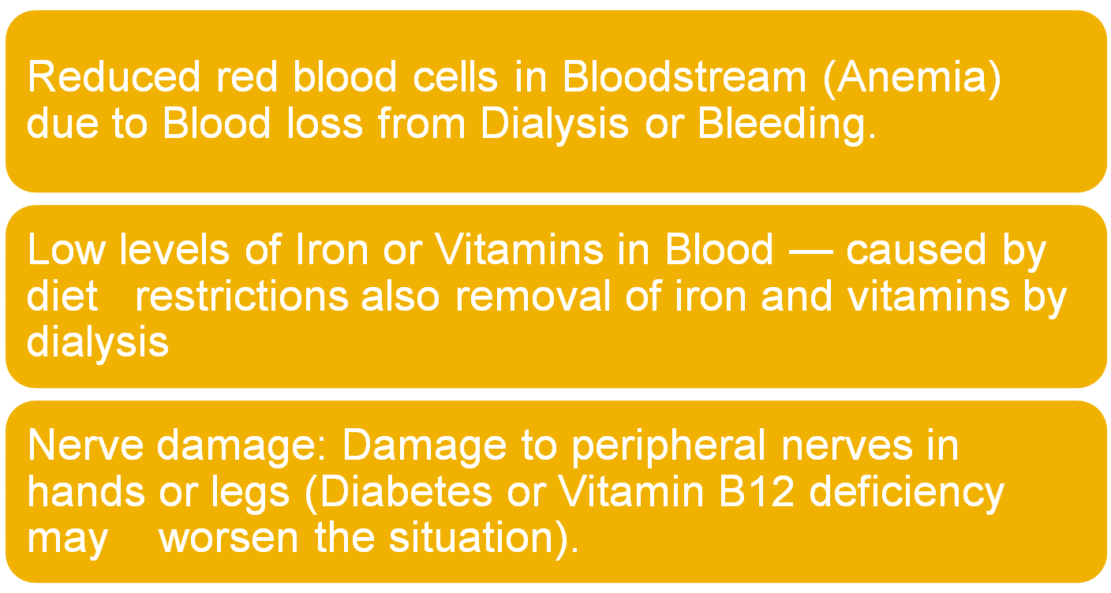
Complications of Hemodialysis

Slide 45
Peritoneal Dialysis
The process takes place inside the body.
A tube (catheter) is inserted into the abdomen during operation.
Special dialysis fluid is drained into the abdomen.
Excess waste and water pass from the blood into the fluid and after a few hours the fluid is drained out.

Slide 46
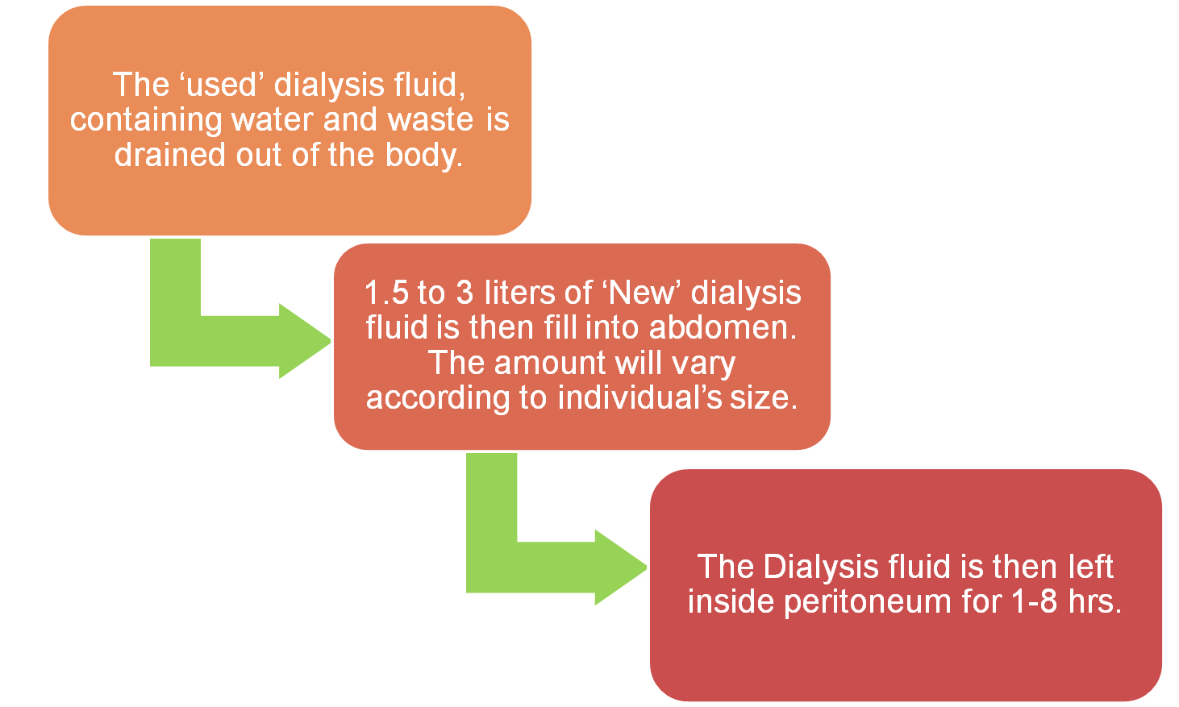
PD as a Three-step process:

